Slide 1
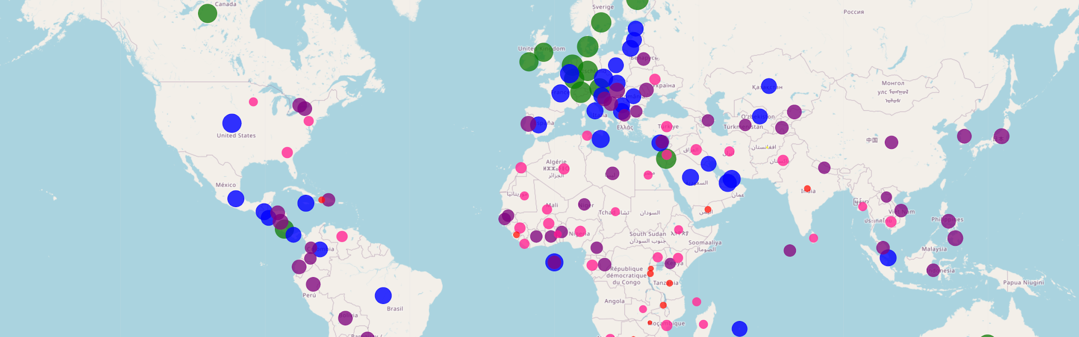


Happiness & Well Being: “The Science Behind Your Happy”.
Nick Nath, Nancy Zheng, Tan Vale, Iris Michelsen

Slide 2

Project Data Background
(World Happiness Report 2021)
Dataset: A 2021 study of 150 countries:
Social Support
Freedom to Make Life Choices
Logged GDP per Capita
Generosity
Healthy Life Expectancy
Study Appendix:
https://www.kaggle.com/datasets/ajaypalsinghlo/world-happiness-report-2021
Happiness scores and rankings are based on data from the Gallup World Poll

Slide 3
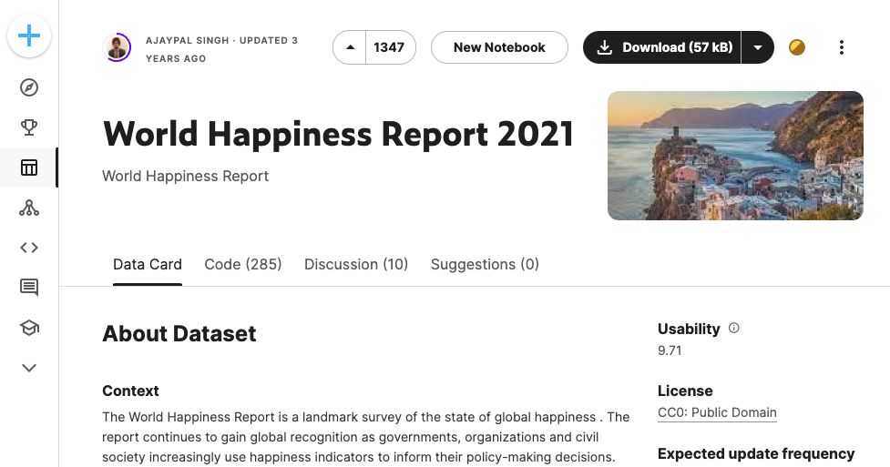
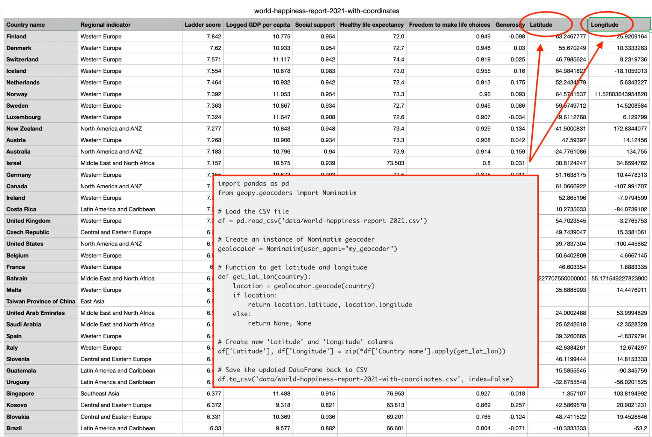


Slide 4

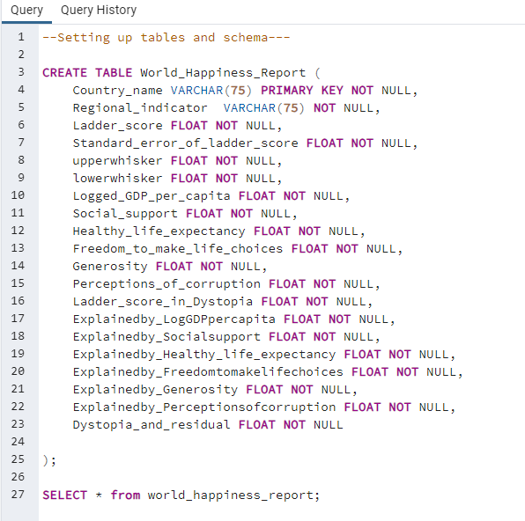
Postgresql - Coding Snapshot
Study Appendix:
https://www.kaggle.com/datasets/ajaypalsinghlo/world-happiness-report-2021

Slide 5

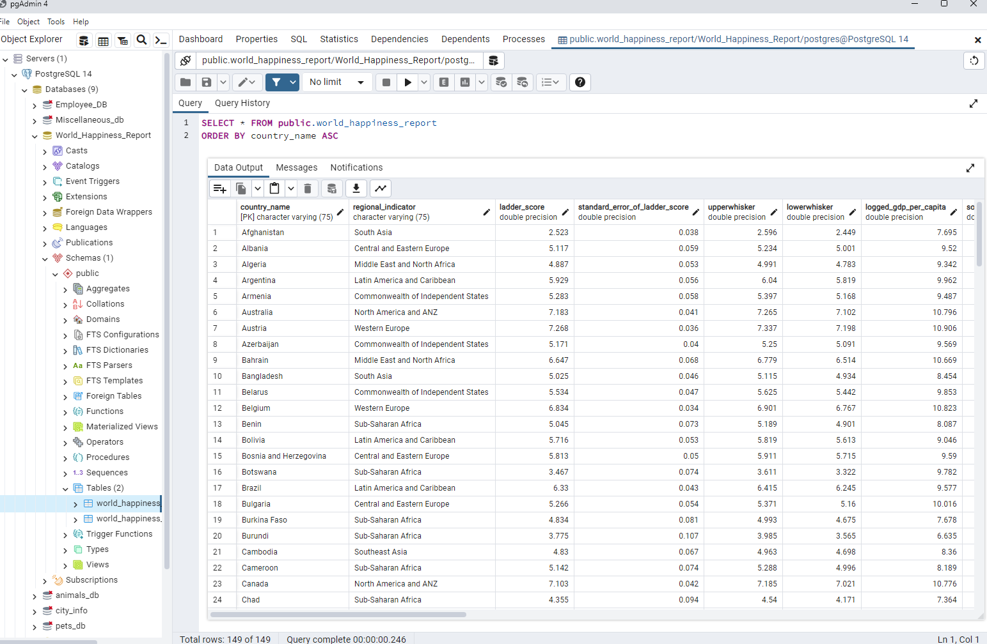
PgAdmin: Table Overview
Study Appendix:
https://www.kaggle.com/datasets/ajaypalsinghlo/world-happiness-report-2021

Slide 6

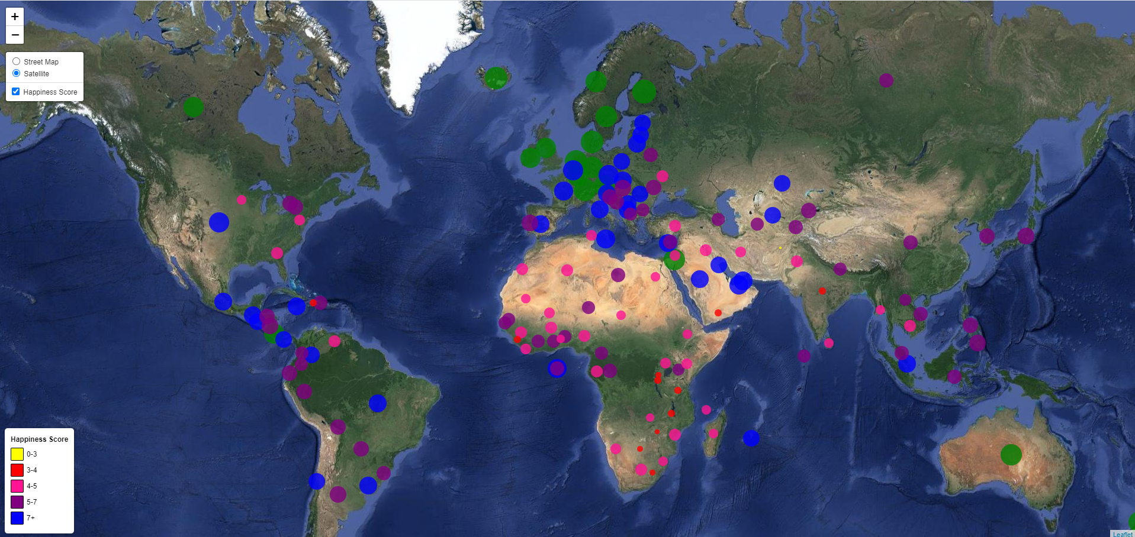
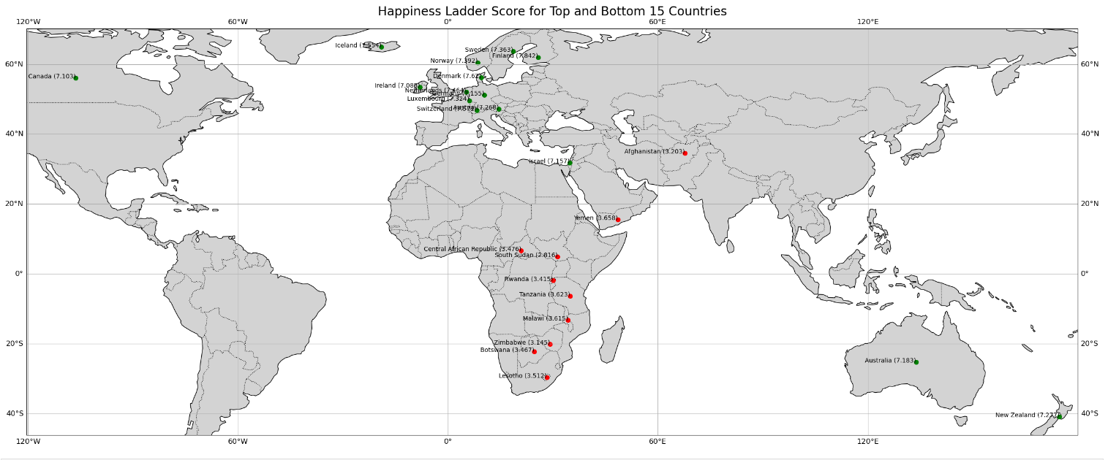
Leaflet: Happiness Score Map
Outliers and Health Indicators:
The presence of outliers, in younger and older age groups, may indicate health disparities or exceptional cases that could warrant further investigation.

Slide 7

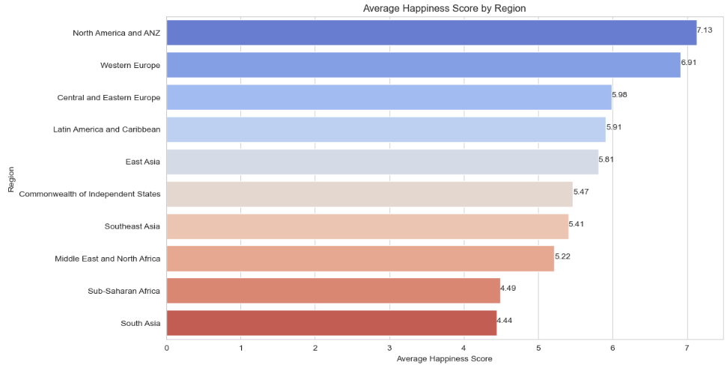
Average Happiness Score by Region
North America and ANZ (Australia and New Zealand) have the highest average happiness score, sitting just above 7.1.
Western Europe follows closely, with an average score just below 7.
The Central and Eastern Europe, Latin America and Caribbean, and East Asia regions display moderate average happiness scores, ranging approximately from 5.8 to 5.9.
Commonwealth of Independent States, Southeast Asia, and Middle East and North Africa regions have average scores between roughly 5.2 and 5.5.
Sub-Saharan Africa and South Asia have the lowest average happiness scores, with both just above 4.4.
Study Appendix:
https://www.kaggle.com/datasets/ajaypalsinghlo/world-happiness-report-2021

Slide 8
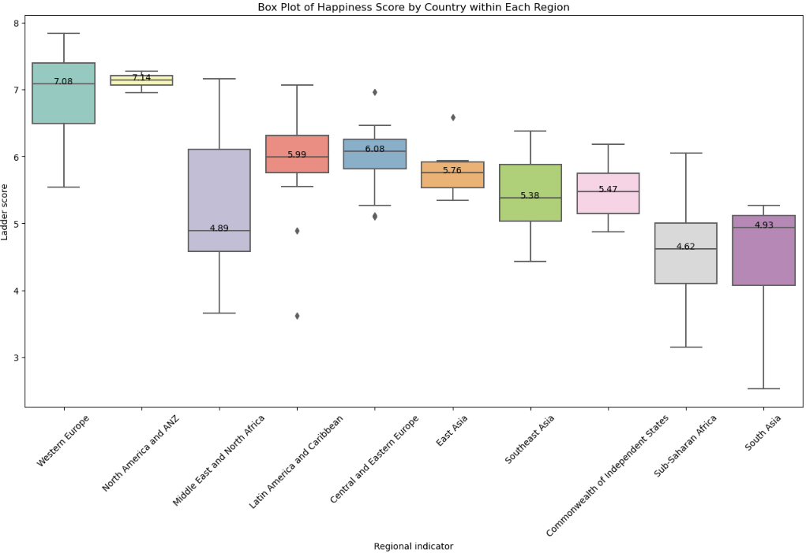
Happiness Score by Country within Each Region
North America and ANZ (Australia and New Zealand) have the highest average happiness score, sitting just above 7.1.
Western Europe follows closely, with an average score of 7.08
The Central and Eastern Europe, Latin America and Caribbean, and East Asia regions display moderate average happiness scores with a median of Commonwealth of Independent States, Southeast Asia, and Middle East and North Africa regions have average scores between roughly between 5.5 and 5.7.
Sub-Saharan Africa and South Asia have the lowest average happiness scores, with both just around average of 4.7
Study Appendix:
https://www.kaggle.com/datasets/ajaypalsinghlo/world-happiness-report-2021

Slide 9

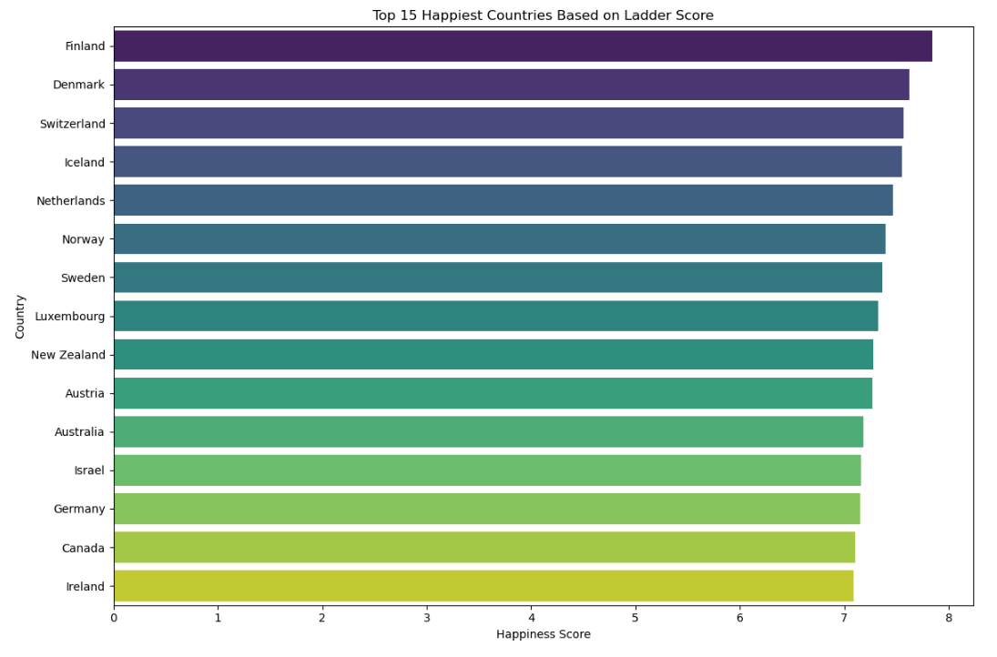
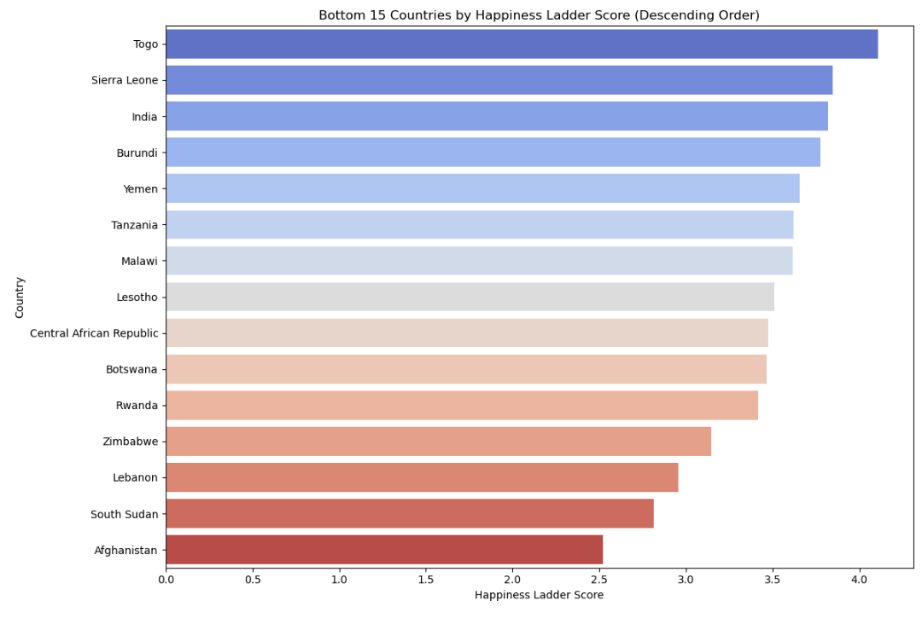
15 Happiest and UnHappiest Countries
15 Happiest Countries
Regions with higher social support and higher freedom to make life choices were the happiest.
Western Europe, Northern America & ANZ had countries with highest scores.
Countries with higher GDP have a higher healthy life expectancy
15 Unhappiest Countries
Regions with lower social support may exhibit less freedom, potentially due to social, economic, or political constraints.
African and Middle Eastern Countries have lowest healthy life expectancy and GDP
Healthcare, Nutrition, Living Conditions
Study Appendix:
https://www.kaggle.com/datasets/ajaypalsinghlo/world-happiness-report-2021

Slide 10

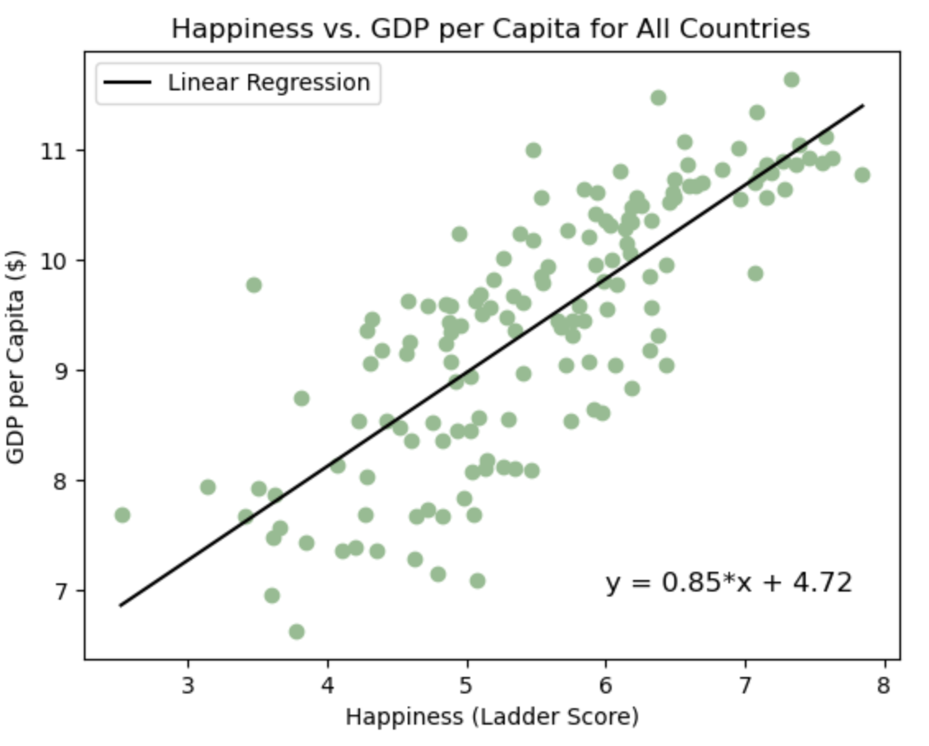
GDP per Capita
This was the variable with the strongest correlation to happiness
The r-value was .79
How GDP influences happiness:
Basic needs satisfaction
Standard of Living
Stability
Limitations
Diminishing returns
Wealth inequality

Slide 11

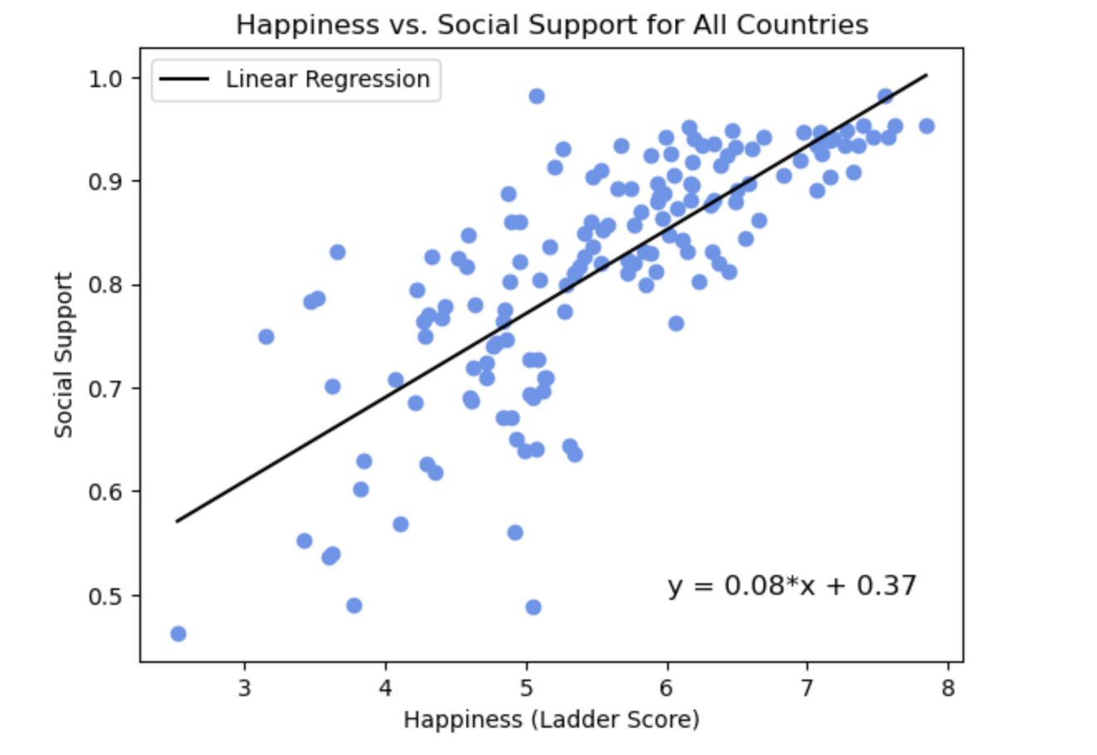
Social Support:
This variable also had a very strong correlation with happiness
The r-value was .76
This does have more outliers than the GDP per capita scatterplot
Social support can influence happiness on both individual and societal levels (mental health, resilience, etc)
The dataset does have limitations, such as the way that the question is framed

Slide 12
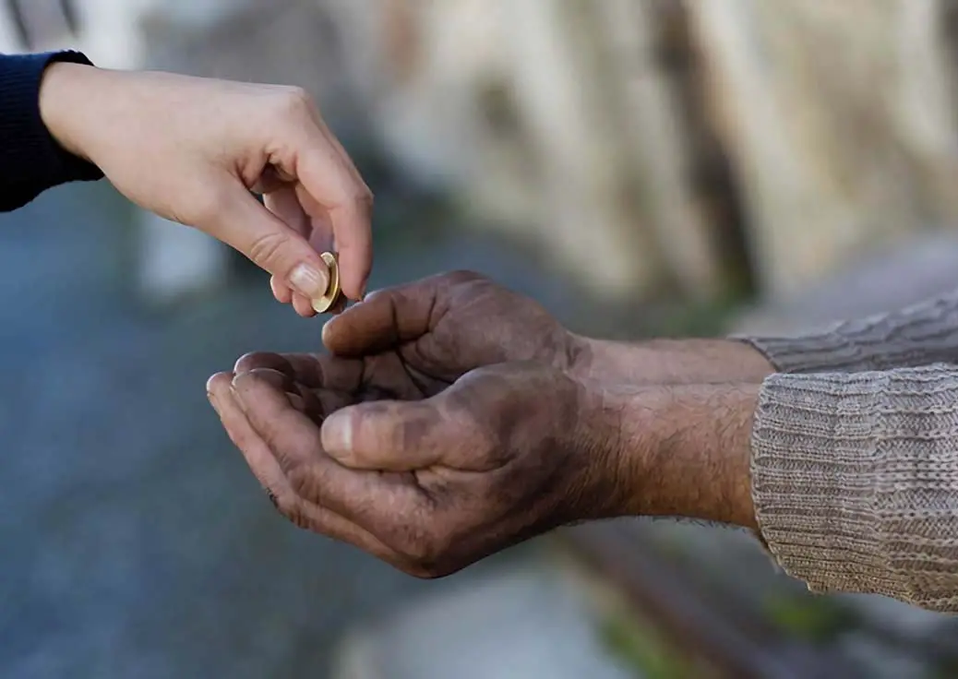
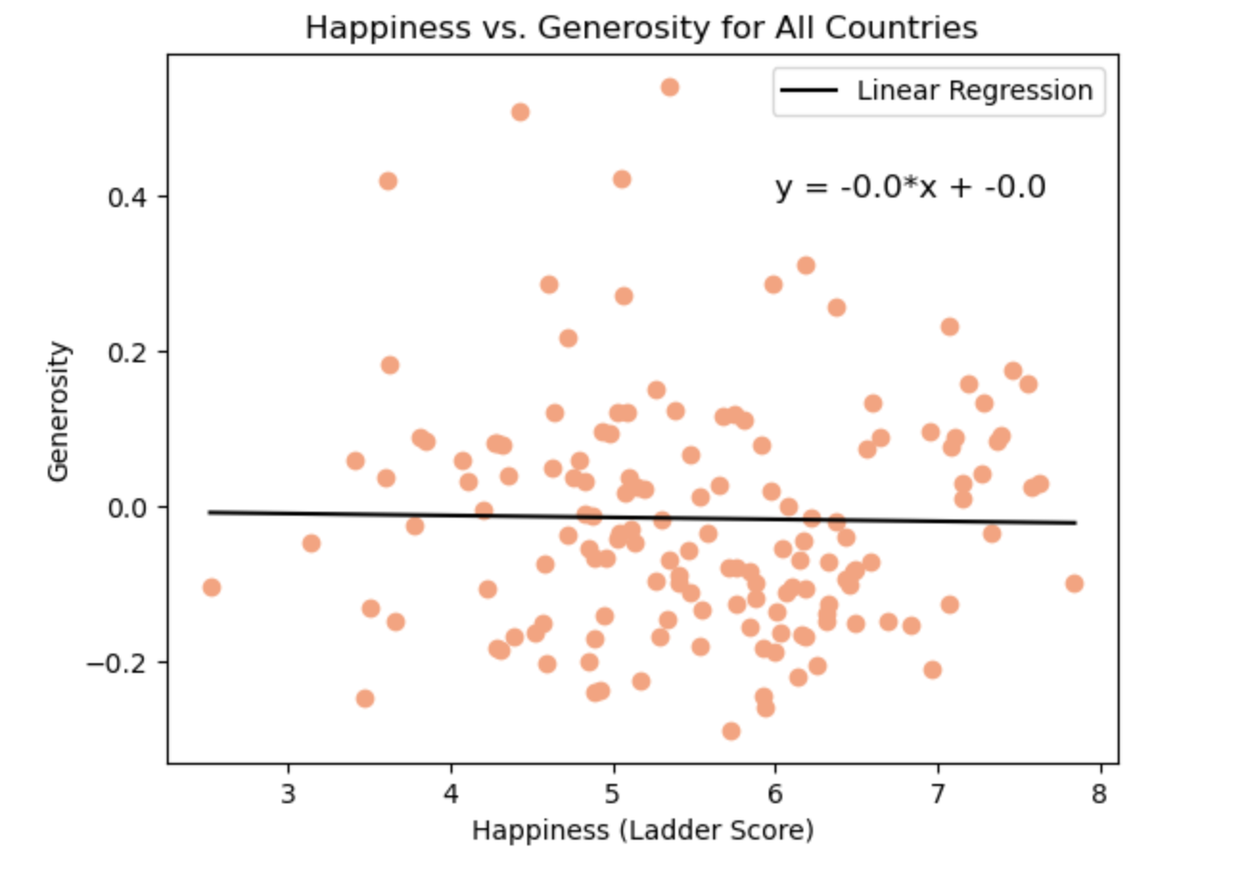
Generosity:
This variable had a very slight negative correlation with happiness
The r-value was -0.02
This could be explained by the way the data was collected, according to the appendix, “Generosity is the residual of regressing national average of response to the GWP question ‘Have you donated money to a charity in the past month?’ on GDP per capita”
This is a limited representation of generosity

Slide 13

Findings
Happiness is complex and subjective
Weigh differently for different people and societies.
The ultimate path to happiness often involves a balance of these various elements tailored to individual and cultural contexts.

Slide 14

Questions?

